Slide 1

Topic Modeling Approach to Improve Twitter’s Search Algorithm

Slide 2

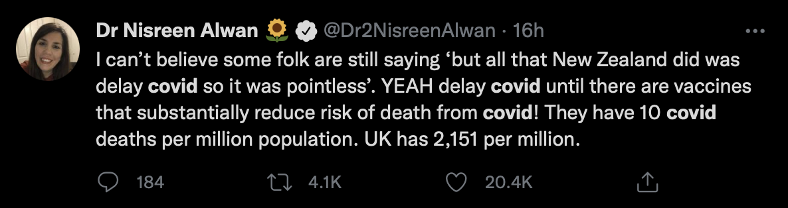
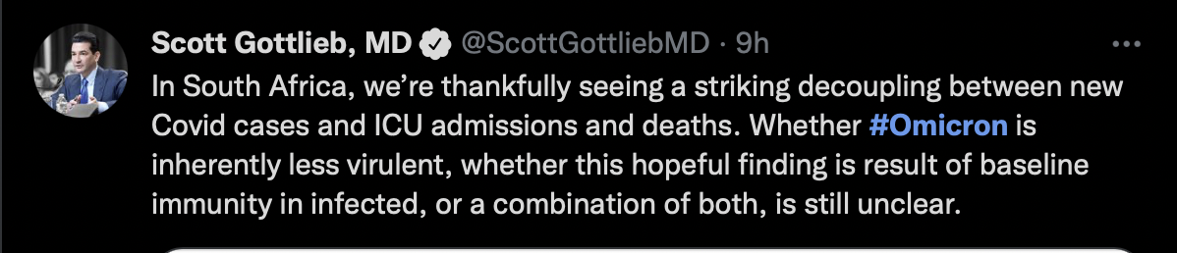


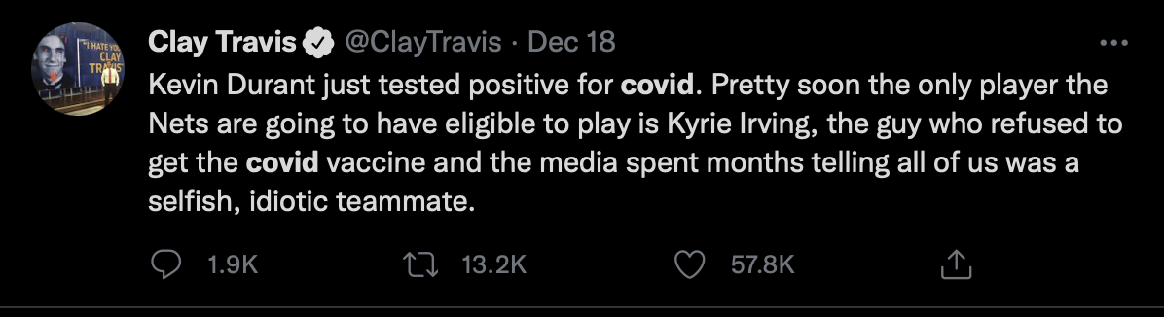
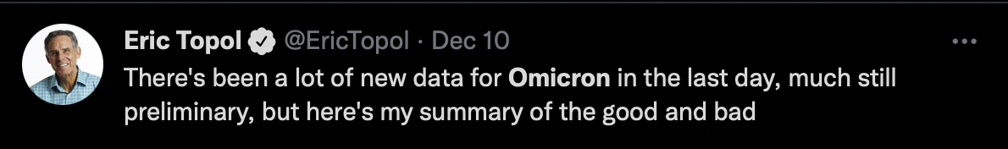
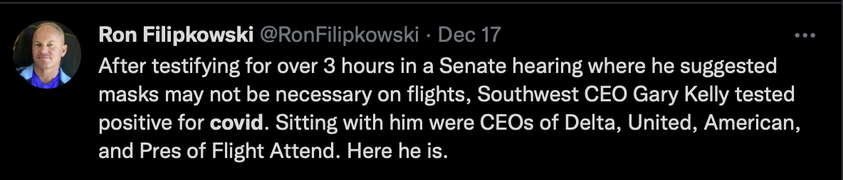
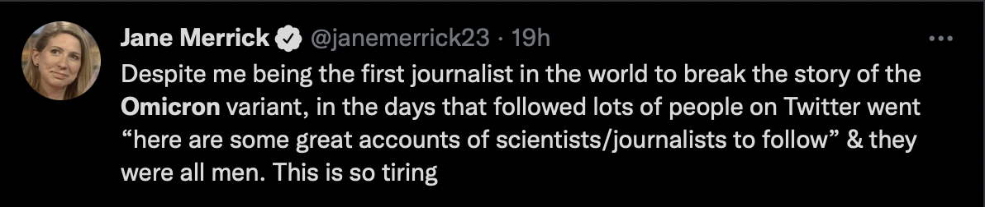
COVID vs OMICRON
Notes:
When you search for COVID on twitter, the top search results on Sunday were
And When you searched for Omicron, the top search results were
The constant between the search results on the left is – it contains the word COVID
The constant for the search results on the right is – it contains the word Omicron
But both are essentially talking about the same thing- same TOPIC – broadly speaking
Twitters search query algorithm is keyword based..not context based
One way to improve these search results is by associating words with certain topics and smartly figuring out what the user is looking for
For eg if the user searches for case or case-count or third wave or hospitalizations or omicron, the algorithm should smartly detect that the user is looking to find information about covid with the focus keyword being the search term
So how can we do that? This where is topic modeling can add more context to the search results
There are other ways twitter do shows contextual based search results like for eg in its trending section where it curates the search results based on topics

Slide 3
What is Topic Modeling?
The term ‘Topic’ refers to a set of words that one would associate to when they want out to find out more about that topic. E.g. NBA-the topic, the words that could be associated are ‘Lebron James’, ‘Bulls’, ‘games’, ‘playoffs’ etc.
‘Modeling’ refers to the use of algorithms to discover topics appearing in documents.

Slide 4
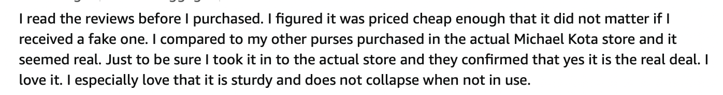
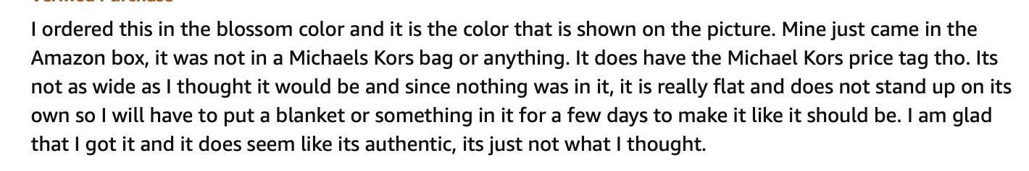
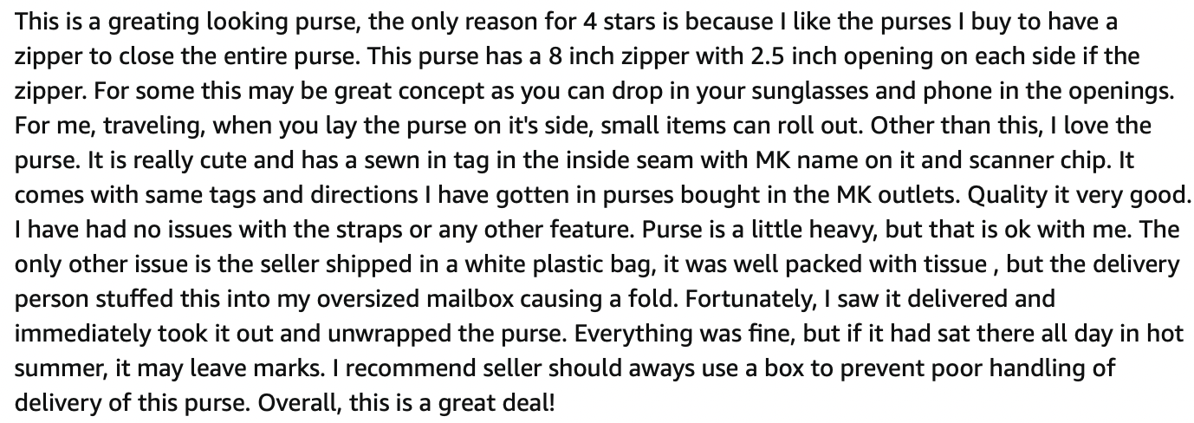
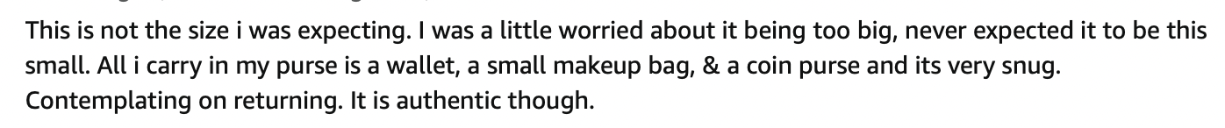
A single document is usually composed of multiple topics
PRICE
AUTHENTICITY SIZE APPEARANCE
Notes:
Some general intro on what a topic model is
Topic Model assumes that documents are composed of words that help determine the topics and maps documents to a list of topics by assigning each word in the document to different topics.

Slide 5
Outputs of a Topic Model
Clusters of documents that the model has grouped based on topics and
Clusters of words (topics) that the model has used to infer the relations.

Slide 6
Motivation
Twitter attracts a wide range and variety of users and topics, and users of the platform use it as an outlet to discuss and inform their viewpoints.
Valuable text mining data pool that can be leveraged to discover the underlying themes of conversations happening at any given time
However, manually reading and making sense of all the tweets to identify the themes and topics of discussions is not always practical.
A text mining approach can be adopted to get a big picture idea of general discussion topics.
Topic modeling can help distill information into a more usable and actionable format.
Notes:
Twitter is one of the most popular social media platforms, and it currently has over 396.5 million users.
Twitter is a microblogging and social networking service.
Users post tweets, short text messages to interact with their followers.
The text content of a tweet can contain up to 280 characters.
Users can post and talk about any topic they wish to, provided they do not violate the Twitter rules.
Given the open platform nature of the service, Twitter attracts a wide range and variety of users and topics, and users of the platform use it as an outlet to discuss and inform their viewpoints.
Twitter is a valuable text mining data pool that can be leveraged to discover the underlying themes of conversations happening at any given time. E.g., an organization would like to understand the discussions around their products.
However, manually reading and making sense of all the tweets to identify the themes and topics of discussions is not always practical.
A text mining approach can be adopted to get a big picture idea of general discussion topics. Topic modeling can help distill information into a more usable and actionable format.

Slide 7
Problem Statement
As a data science engineer at Twitter-India, I am tasked to improve Twitter's search algorithm to show more context-based results rather than just query-based results.
I use topic models to discover latent themes in the users' posts specifically originating from India to improve the search engine's performance.
Helping users find relevant information will lead to more engagement on the platform and drive user monetization.
Notes:
As a data science engineer at Twitter-India, I am tasked to improve Twitter's search algorithm to show more context-based results rather than just query-based results.
I use topic models to discover latent themes in the users' posts specifically originating from India to improve the search engine's performance.
Helping users find relevant information will lead to more engagement on the platform and drive user monetization.
To do so,
I analyze the Twitter activity of users from **India** over the last two years (Sep-2019 to Sep-2020).
*Topic models* are used to discover and identify trends in the underlying themes in the topics being discussed on the platform.
COVID played a big part in the last two years and greatly influenced how users interacted on social media platforms.
Topic models can provide insights into any specific trends that could correlate with the rise and the fall in the number of COVID cases in India.
Since topic modeling is an unsupervised machine learning technique, our analysis and results are driven by how well the topic models capture the relevant topics.

Slide 8
Modeling Options
Some of the well-known topic modelling techniques are Latent Semantic Analysis (LSA), Probabilistic Latent Semantic Analysis (PLSA), Latent Dirichlet Allocation (LDA), and Correlated Topic Model (CTM).
LDA Models:- The word ‘Latent’ indicates that the model discovers the ‘yet-to-be-found’ or hidden topics from the documents. ‘Dirichlet’ indicates LDA’s assumption that the distribution of topics in a document and the distribution of words in topics are both Dirichlet distributions. ‘Allocation’ indicates the distribution of topics in the document.
Short Text Topic Modeling:- Gibbs Sampling Dirichlet Mixture Model assumes one topic per document. Based on Gibbs sampling

Slide 9
Dataset
Snscrape has a Python wrapper for Twitter with support for users, user profiles, hashtags, searches, threads, and list posts. It has 2 distinct advantages over Tweepy:
You do not need an API key to scrape tweets.
Snscrape's search function works the same way as Twitter's search.
I used the ‘near’ ‘Geo’ operator to filter out tweets by location around the top 25 cities by population in India.
A typical search query to scrape tweets around a given city will look something like this:
`f'near:{city} within:200km since:{since} until:{until} lang:en -filter:retweets -filter:replies filter:verified')`.
The ‘city’, ‘since’ and ‘date’ parameters represent a given city name, start date and end date of search query respectively.
I applied additional filters to the search results to limit the number of search results.
The final dataset contained 400k tweets
Notes:
Snscrape API to scrape tweets. Snscrape is a scraper for social networking services (SNS). It has support for several social media services such as Twitter, Facebook, Instagram, etc.

Slide 10
Modeling Methodology
Short Text GSDDM model fitted on the entire corpus
A three-step modeling approach for the LDA model is adopted
Base LDA model for the entire corpus
Tuning the Hyperparameters to improve over the base model
Build a model for each month by limiting the corpus for that month and tune their hyperparameters
Notes:
The first two steps provide models that reveal topics of interest over the entire two year period. However, since topics evolve over time a monthly model should be better able to capture relevant topics for that given month instead of generalizing over a longer timeframe.
This model takes 6 hours to run for 50 iterations on Google Colab. Hence, even though this model reveals much more coherent topics than the LDA model, it could not be more extensively used as the LDA model due to its slow run time.

Slide 11
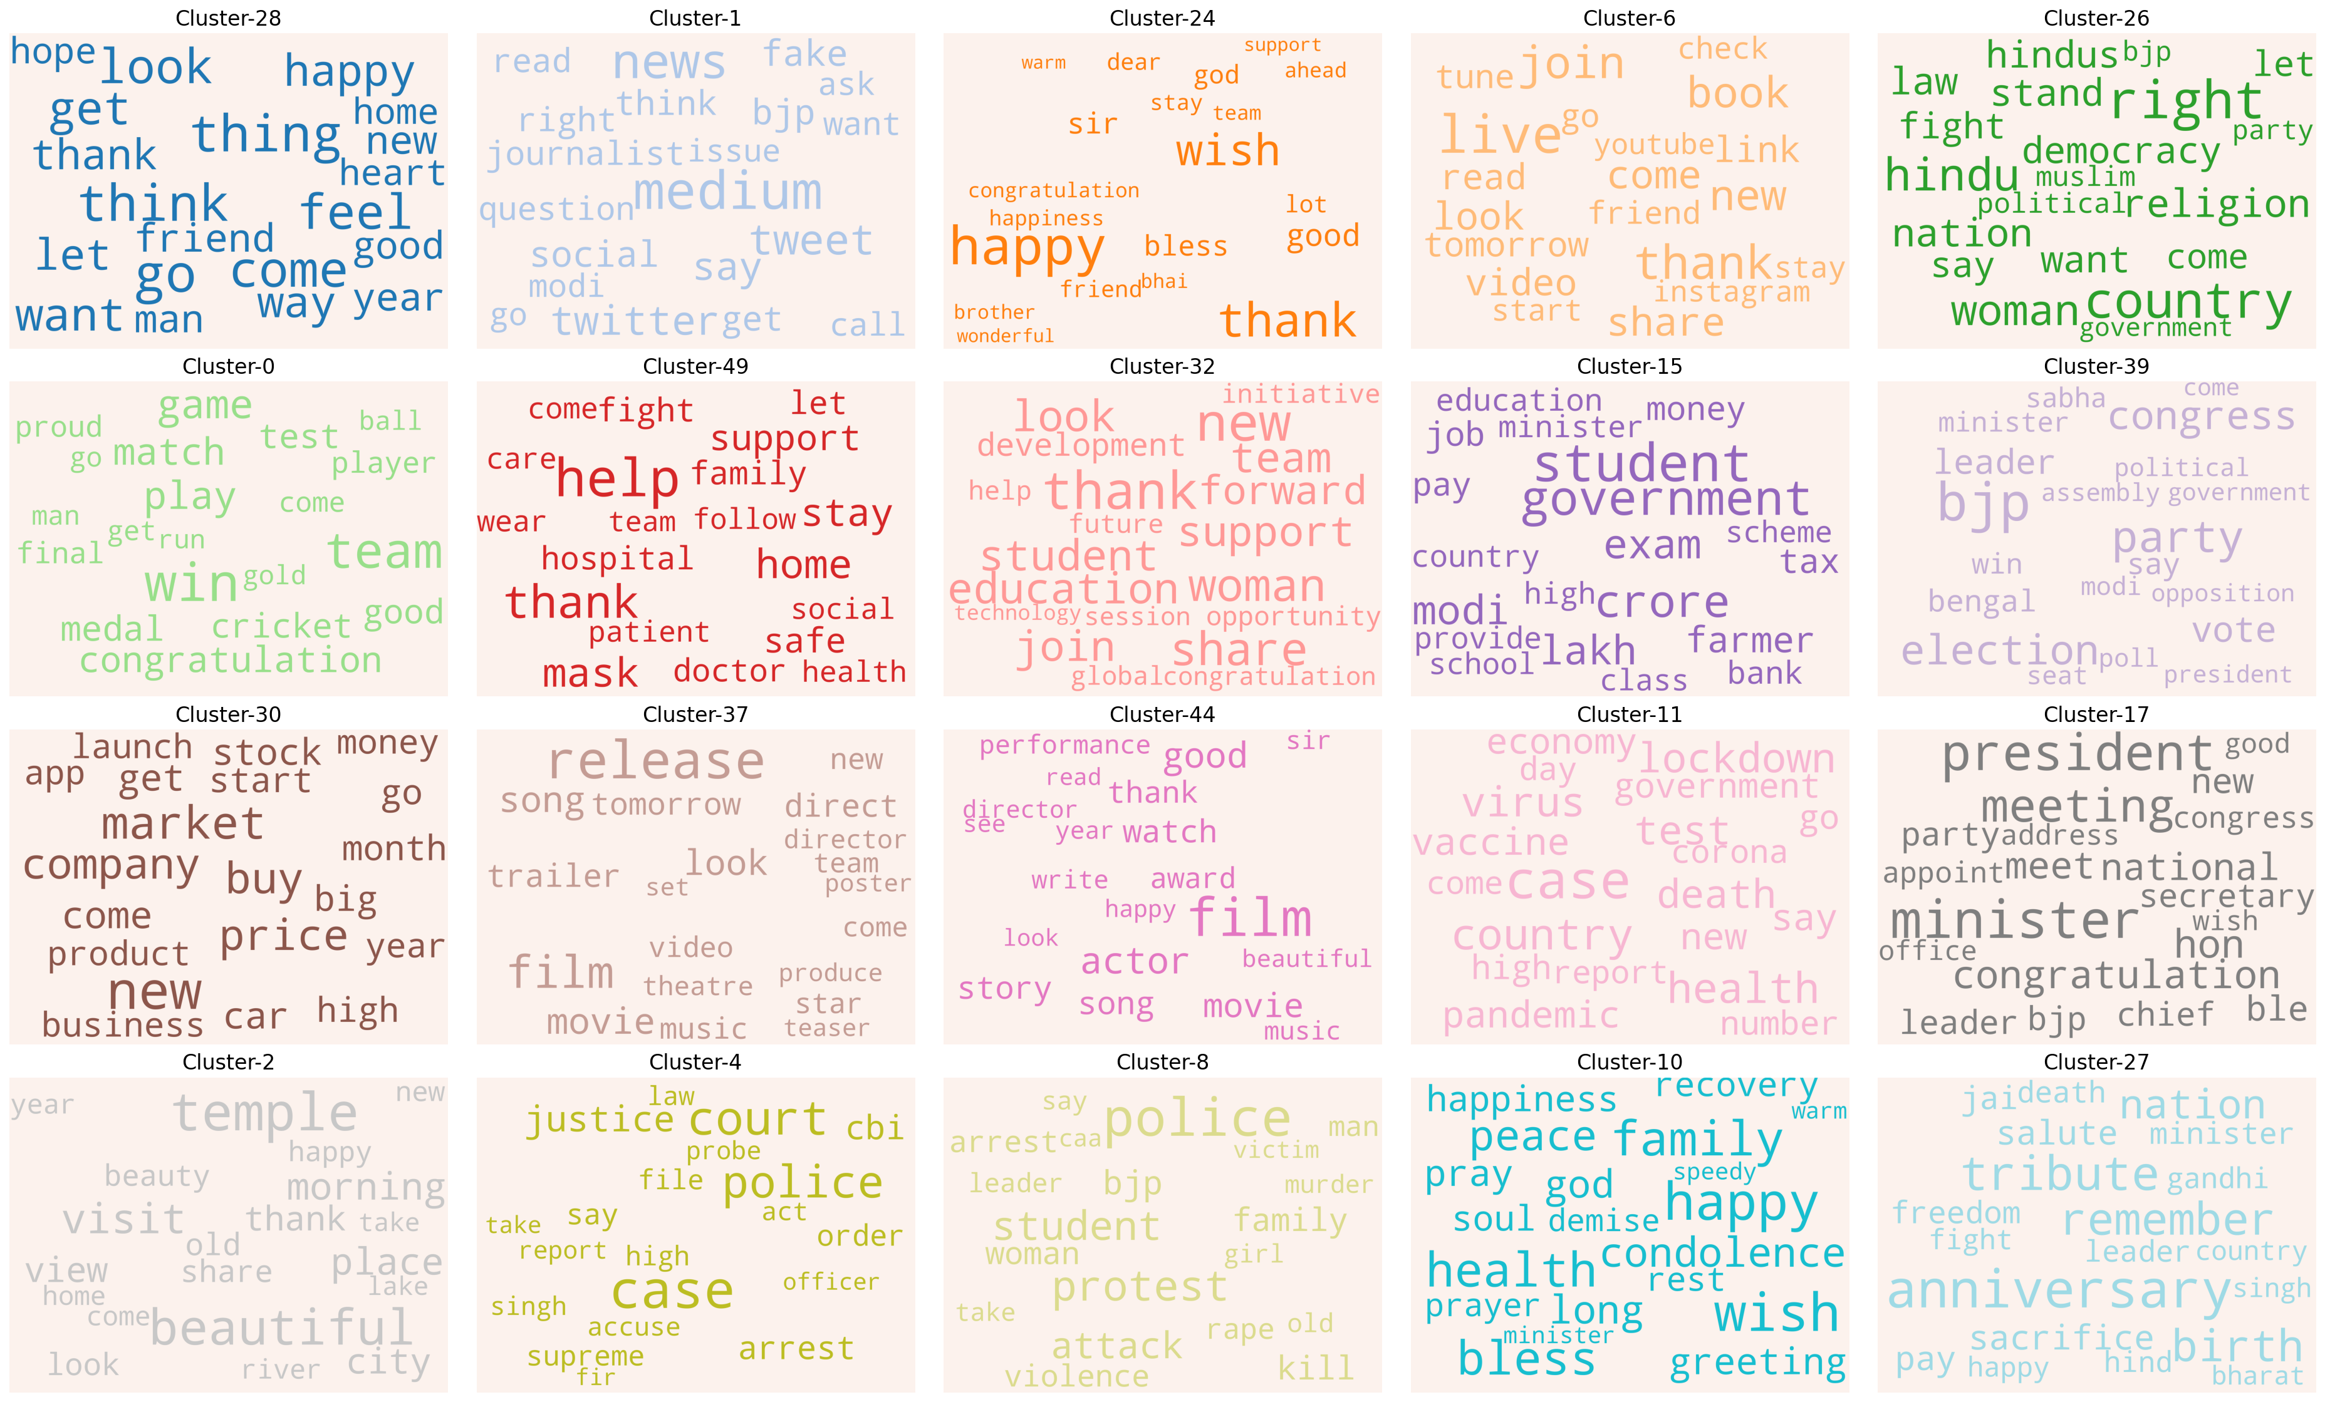
Social Media and Fake News
Birthday Wishes and Congratulations
Live Streaming Promotions
Religion
+
Politics
Wishing the best
Cricket
+
Sports
COVID well wishes
Women, Education and Students
COVID
&
Students
Elections
COVID Measures (Lockdown+Vaccine)
Stocks
&
Businesses
Audience Review
Party in Power at the Center
Film Promotions
COVID Deaths &
Condolences
Anniversary
&
Independence Day
Visiting Places
Law
&
Order
Public Protests
Notes:
Lets look at the results for the Short text topic modeling approach.
This is word cloud showing each topic and their associated high frequency words, sized by their frequency
We just go through each topic and the words to see based on what we know, what the topic possibly could be.
So here I try to label each of these cluster of words to a topic I found to be more relatable.
Lets run through some of the examples

Slide 12
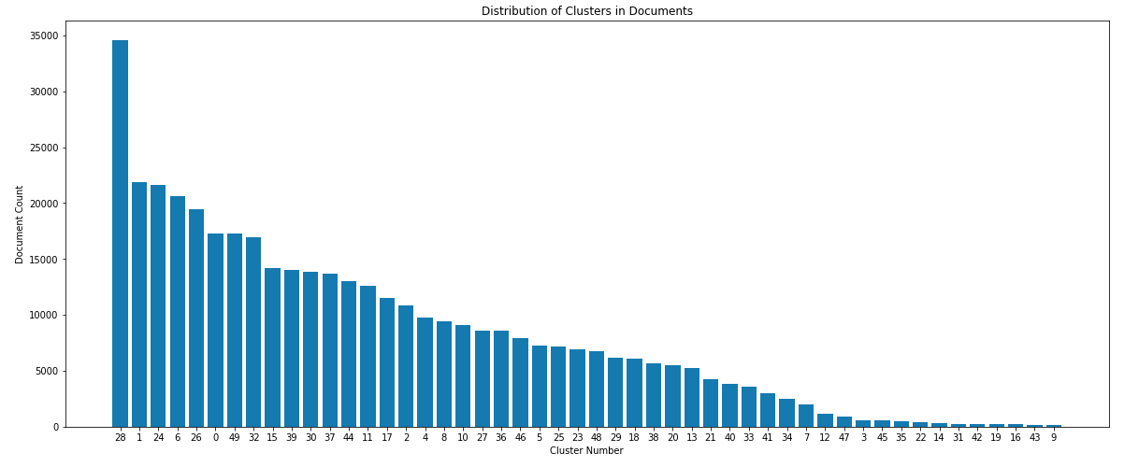
Results … cont’d
Notes:
Shows the distribution of clusters in documents
Topic 28 which was about just general wishes is the most occurring topic in all the documents
I guess the bottom 15 topics occur in such lower frequency, we can either lump them into one or they are indeed distinct topics
Will need some tuning of the model paramters
This model takes more than 6 hours to run for the entire corpus and as you will see later, even though it did a better job at identifying coherenct topics, its usage is limited due to slow run times
I did a more extensive modeling study using the LDA model

Slide 13
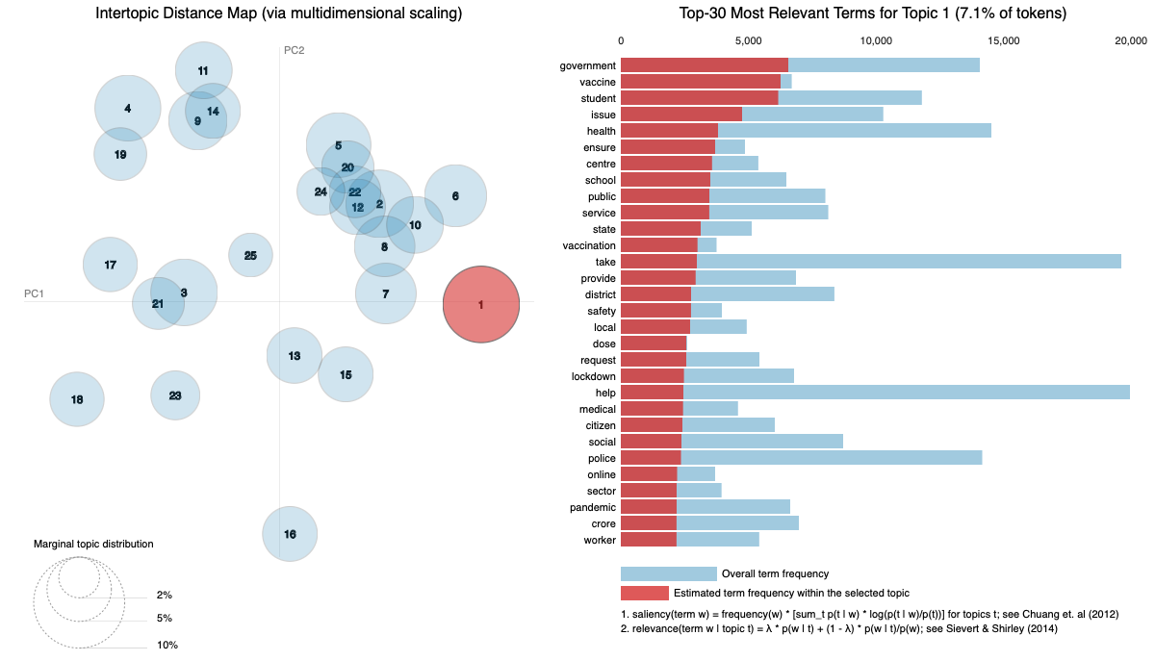
Base LDA model
We are aiming to see circles which are more spread out and with minimal overlap which is a representation of a model that is picking up distinct topics
Notes:
The base model was run with 25 topics
A good way to evaluate the performance of LDA models, is using pyLDAvis library which plots the Intertopic Distance Map on PC axes.
We are aiming to see circles which are more spread out and with minimal overlap which is a representation of a model that is picking up distinct topics
When you hover over a particular bubble, the plot on the right shows the words and their occurrences in a given topic. By default, a LDA model will assign all the words in the vocabulary to a topic but the probabiltiies will be totally different. And you can sort these words by their probabilities to see the likelihood of a word to be associated with a given topic. The red shows the distribution of the words in that topic and is sorted high to low and blue shows the the distribution in entire corpus
The top topic (1) is composed of words such as `government`, `vaccine`, `student`, `issue` and `health` which could mean the topic being discussed has some components of government intervention in covid and priorities related to student likely the schools being closed due to pandemic.
In this way you can try to interpret the topic based on the cluster of words being associated with that topic
There is always a human element involved to evaluating LDA models.

Slide 14
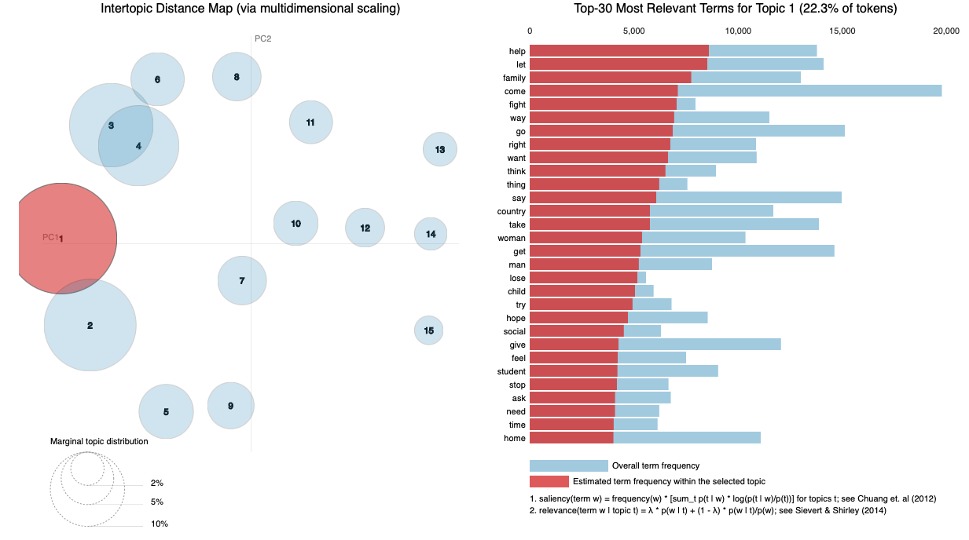
Best LDA Model
After tuning of hyperparameters, the best LDA model ranked by coherence score has 15 topics
Notes:
Ther are 2 hyperparamters, number of topics is the one we are really interested in and learning_decay which controls the learning rate.
To choose the best models, we can rank all the models based on their Topic Coherence score.
It is a measure a single topic by measuring the degree of semantic similarity between high scoring words in the topic. These measurements help distinguish between topics that are semantically interpretable topics and topics that are artifacts of statistical inference. Coherence measures the relative distance between words within a topic …
So the top ranked LDA model had number of topics = 15 and learning decay of 0.5 and the score was 0.45, base model had a score of 0.45
One more thing to note is that the 2nd ranked model had a score of 0.4933 which is not much different from the first model. But it had 25 topics. This kinda shows how tricky these LDA models are to score and rank and chose the best ones
What is coherence?
A set of statements or facts is said to be coherent, if they support each other. Thus, a coherent fact set can be interpreted in a context that covers all or most of the facts. An example of a coherent fact set is “the game is a team sport”, “the game is played with a ball”, “the game demands great physical efforts”

Slide 15
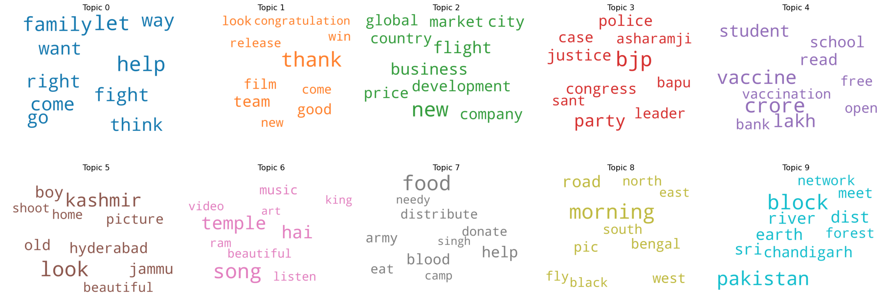
WordCloud – Top 10 Topics
Film Promotions
Religion
+
Politics
COVID Measures
Help

Slide 16
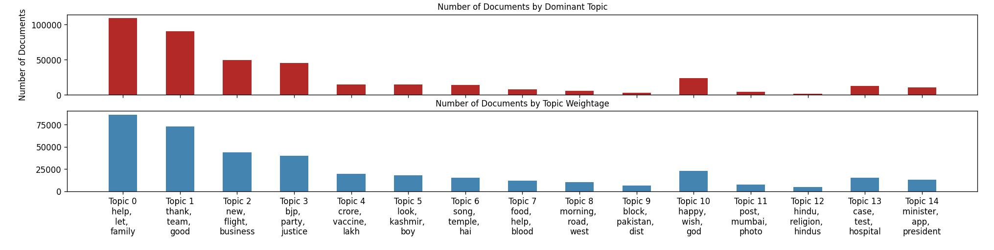
Document Count Distribution
Notes:
We can look at the distbution of topics in the corpus. Just to get an idea of how dominant a particular topic is
The top plot shows the absolute number of topics distribution in the corpus
The bottom plot shows the distribution of weights
As we can see the topi 4 topics are the most dominant amongst all the topics. Which is a totally different from what we see in the GSDMM model. So both the models are behaving differently and picking on different topics. Just to note both models have different number of topics

Slide 17
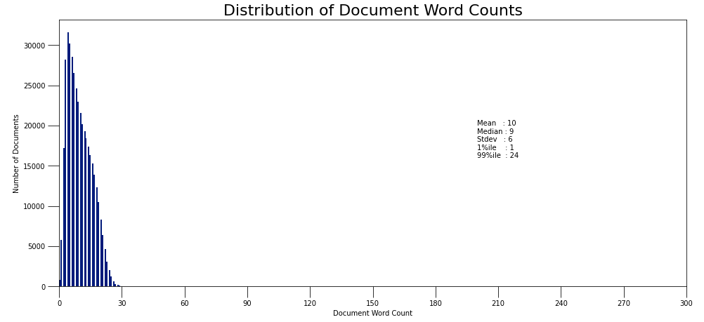
Distribution of Document Word Counts
Notes:
One other plot I looked at was distribution of document word counts. As you can see the max number here is around 30. It should be around 280 which is the max tweet length
But this is an artifact of the custom stopwords that I ended up using so as to improve the model. There were lot of words which were constantly appearing for eg India, day, good, today, birthday which I thought were not adding any more context to the topic and they kept appearing in all the topics in high proporition. So I decided to drop them.
But since those affected the word counts of the documents, it makes me think in general all the tweets were quite similar in nature.

Slide 18
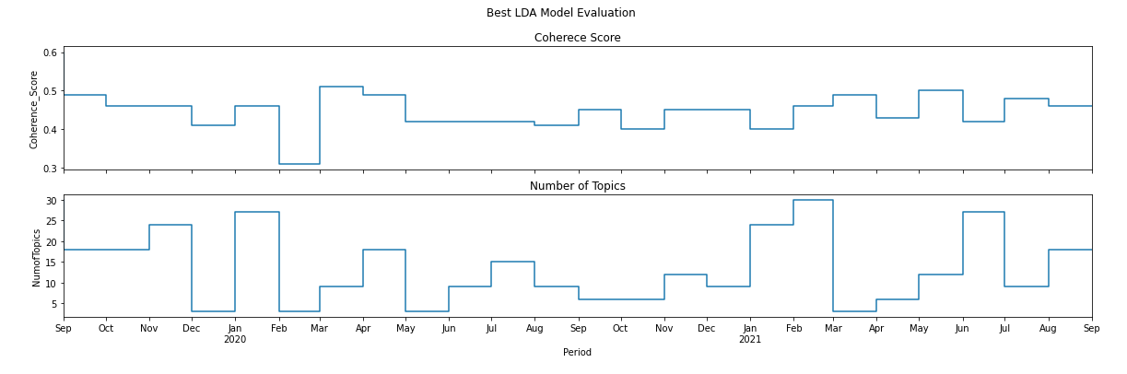
Modeling Trending Topics
Notes:
The next step was to model what I call trending topics here. But this is basically my attempt to extract more coherent topics. My thinking was what ppl talk about is constantly evolving. Topics trends at shorter time interval these days, could be daily, weekly. Monthly. What was relevant 2 years back is most likely not being talked about now or it is being talked about in different context.
So here I modeled the corpus on a montly basis and getting a top topic for that given month. Just to see if there any particular topics that were focus in that month and if it changed in the next month or if it reappeared few months down the line…something of that sort
I again tuned the hyperparameters for models for each month and ranked them by coherence score
Here I am just showing a plot of the coherence scores and number of topics over the last 2 years
As you can see the number of topics the model is picking up for each of these months vary widely between 3 and 30 topics

Slide 19
Incoherent Topic
Diwali Wishes
Thank you Birthday Wishes
Student Protests
Film Promotion
Film Promotion
COVID Stay Home
Lockdown + Migrant Worker
China + India Border
Family + Student
Family + Student
Lockdown
Thank you Tweets
Thank you Tweets
Farmers Protest
Farmers Protest
Birthday Wishes to Guru
Diwali Wishes
Thank you Messages
COVID, Oxygen + Hospital Help
COVID, Oxygen + Hospital Help
Happy Messages
Birthday Wishes
India England Cricket

Slide 20
Conclusions
We have a topic model that can identify distinct topics and cluster of words associated with that topic.
This information can be used to infer the context of a search query and provide a more contextual based result
GSDMM model identifies far more coherent topics than the LDA model

Slide 21
Next steps
Snscrape API uses Twitter’s public search results to scrape the tweets. Twitter does not display all the past tweets for search queries.
The scraped tweets were a small selective subset of all the tweets for the time period. Makes the tweet not so representative
Tune the hyperparameters for the GSDMM model

Slide 22
Acknowledgements
Instructors
Colleagues
Heather Robbins
John D Hazard
Tosin Olamigoke
Mandy Tang
Benjamin Peck
Nelli Aydinyan
Adi Bronshtein
Tim Book, Dr Anderson D Prewitt
Jill Mizell
Shruthi Sarode
Zamzam Sar
Milad Ahmadi
Rahul Mukerjee
Ehsan Gharib-Nezhad
Notes:
I would like to start with Heather. I think I can speak for all of us here. Thanks for being patient with us. She did such a wonderful job at the start to ease us into this new and often intimidating world of data science and made us extremely comfortable and over time more confident about our skills
John for being the extremely resourceful guy and sharing his words of wisdom whenever we would get side tracked with anything
Ben for his very insightful tidbits and always had a very different and helpful take on the problem
Nelli thanks for teaching some of the most crucial topics with such ease
Adi for making this last month equally exciting and keeping us engaged and focused in this last mile.. I think we were getting fatigued but you kept our spirits high and topics more interesting
And last but not the least my wonderful colleagues. We did this together, holding each other hands every step of the way, keeping each other motivated, always been there whenever we felt lost and for making friends for a lifetime. Wishing you all the best.

Slide 24
Backup

Slide 25
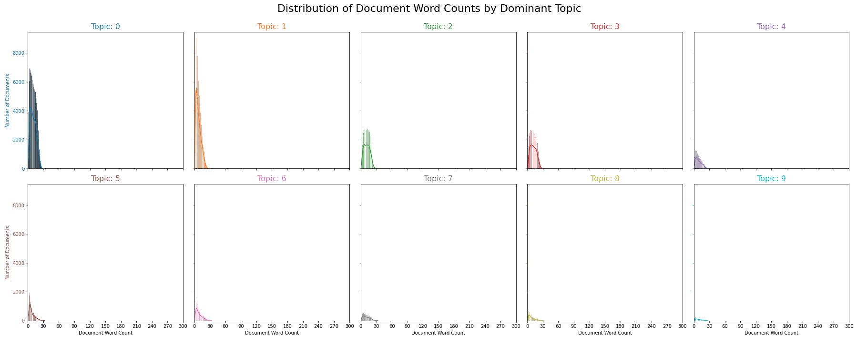

Slide 26
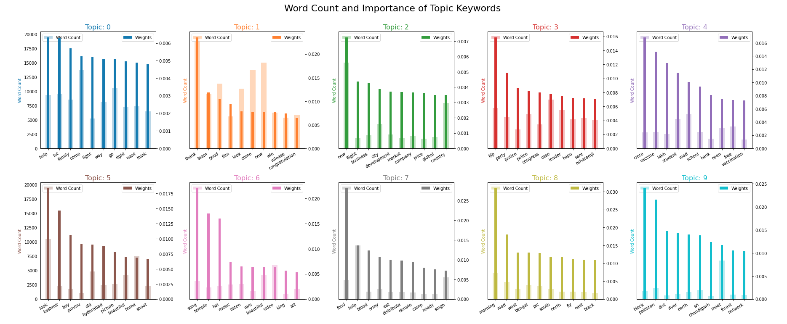

Slide 27
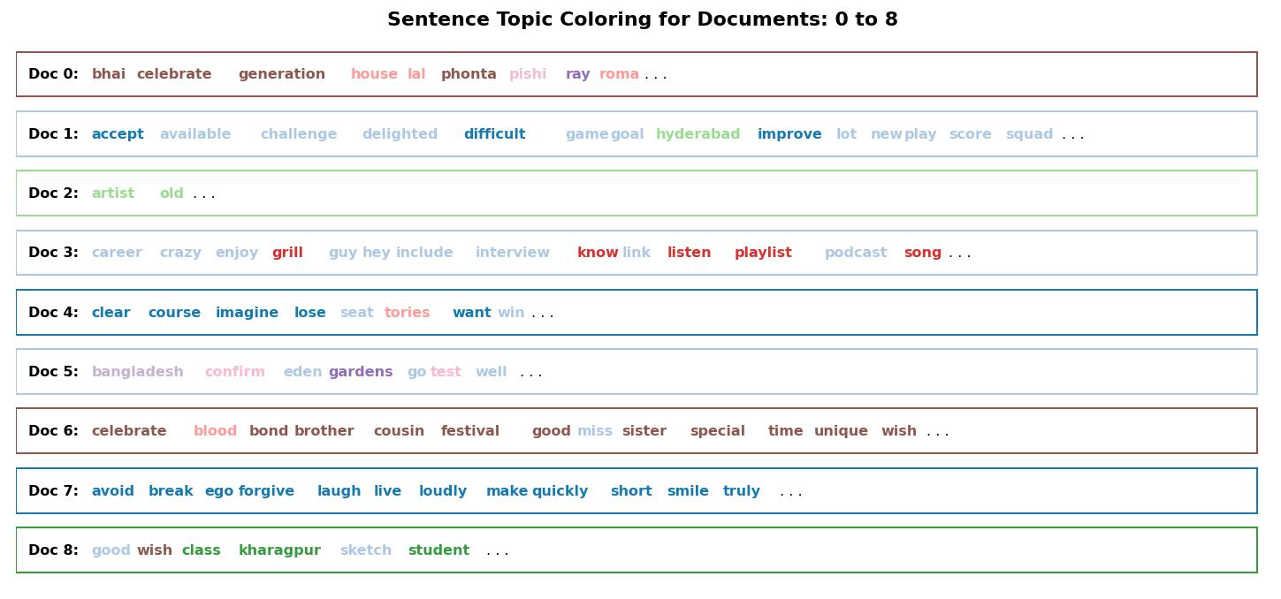

Slide 28
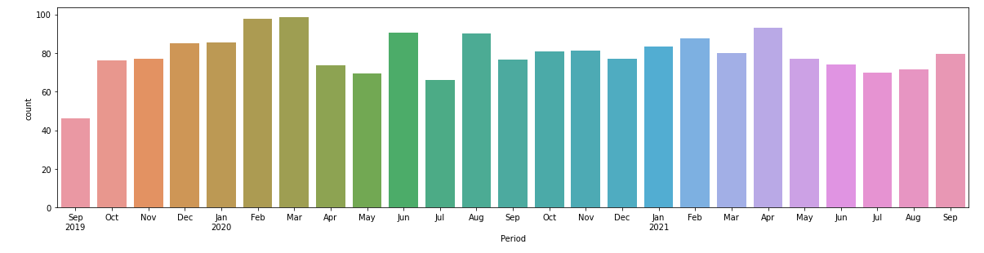
Trending Models – Top Topic % Contribution

